Slide 1
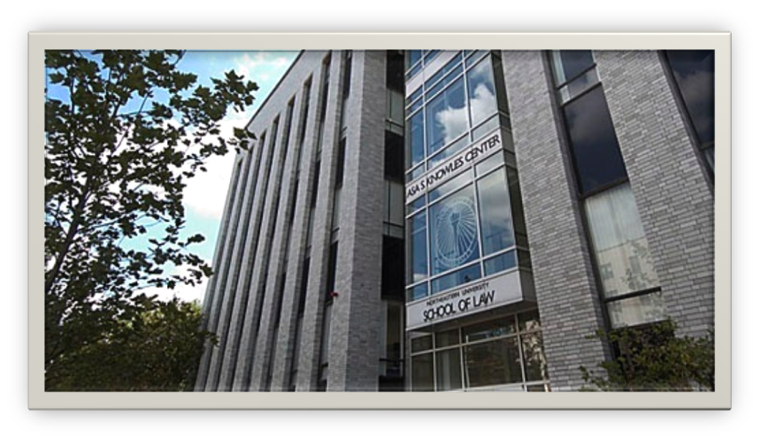
Opportunities for Student Distinction
2010-2011 Internal and External Opportunities
Professor Susan Maze-Rothstein, OSD Director

Slide 2
OSD Internal Opportunities
ASP Teaching Assistants
LSSC Lawyering Fellows
LRW Teaching Assistant
NEU Law Journal
PHRGE Fellowships
Research and Teaching Assistants

Slide 3
Academic Success Program Teaching Assistants
OSD internal opportunity for Fall, Winter, Spring Quarters
Up to 10 Hrs/Wk; $10-13/Hr
Responsibilities
Help 1Ls acquire study skills related to close case reading, case briefing, outlining, and exam prep
Attend weekly meetings with ASP director, and hold office hours for students
Work with 1Ls individually and in study groups
Open to 3Ls with excellent academic and co-op evaluations -
Must be eligible for work-study
To apply contact Professor Melinda Drew at m.drew@neu.edu

Slide 4
Legal Skills in Social Context Lawyering Fellow
OSD internal opportunity with a 3 L Preference for Fall and Winter Quarters for students with excellent academic standing
20-30 Hrs/Wk; $1000 Stipend and 6 credits
Fulfillment of ABA upper-level writing requirement(Fall LF option)
Responsibilities
Completion of the Advanced Legal Skills in Social Context course
Fall- develop the advocacy skills of students and lay foundation for project
Winter- develop plan for project implementation and lead students toward its completion
Rigorous training and Faculty interaction prior to and during fellowing experience
LFs gain advanced strategic lawyering, legal research and writing, oral, management, team lawyering, teaching and facilitation skills
LFs are mentors and 1L role models

Slide 5
Application and Selection
Applications: spring quarter for the fall LFs ; summer for winter LFs
Resume, transcript, writing sample, and statement of interest
LSSC and other course performance, LF and/or faculty recommendation, life experiences, teaching and facilitating experiences, course work in advanced legal research and advanced legal writing, commitment to social justice and diversity in law are all considered
Interested 2L or 3L(preferred) students should contact
Professor Susan Maze-Rothstein at s.maze-rothstein@neu.edu

Slide 6
LSSC Research and Writing Teaching Assistant
OSD internal opportunity with a 3 L Preference for Fall and Winter Quarters
Students with excellent academic standing
10-15 Hrs/Wk; $10.50/hour – Work/Study preferred; Independent Study a possibility
Responsibilities
Attend two hours of 1L Legal Research and Writing classes per week
Assist with class presentations and review of 1L homework assignments
Assist 1Ls with research and writing assignments; meeting with students individually or in groups
Plan and deliver workshops on topics of interest, such as citation format, legal research, outlining, etc.
Gain skills in: advanced legal research and writing, teaching, and presenting
TAs serve as mentors and role models for 1L students.

Slide 7
Application and Selection
Applications accepted: spring quarter for the fall TAs; summer for winter TAs; fall for spring TAs
Application Contents: Resume, transcript, writing sample, and statement of interest
Consideration Given To: LSSC and other course performance, LRW Adjunct and faculty recommendation, life experiences, teaching experience, course work in advanced legal research and advanced legal writing
Interested 2L or 3L(preferred) students should contact
Professor Susan Sloane at s.sloane@neu.edu

Slide 8
Northeastern University Law Journal
OSD internal opportunity for 2Ls and 3Ls
Hone your writing and editing skills, work with regional and national practitioners, improve your resume, and help enhance NUSL’s academic reputation
Journal Overview
Annual symposium on a single, current topic results in a collection of scholarly works written by practitioners. Journal staff edits articles to prepare for annual publication.
Membership is voluntary. Journal staff must attend research and citation seminars, biweekly meetings, complete all assignments, and make a one-year commitment (two consecutive quarters).
Postgraduate, federal, and some state judicial clerkships often require journal experience.
Interested students should contact Christine McCleney, Interim Editor-in-Chief, at nulj@nulj.org or Kate Hawkins, at hawkins.m@neu.edu

Slide 9
PHRGE Fellowships
OSD internal opportunity with 3 fellowships/ quarter
National Law Center on Poverty and Homelessness (Washington, D.C.)
Centre on Housing Rights and Evictions (Geneva)
Oxfam America (Boston)
Travel assistance, $3500 stipend, fulfills co-op requirement
3L preference
Overview
Work with cutting-edge organizations in creative environments
Gain legal skills such as Brief Writing, Strategic Litigation, Legislative Advocacy and Domestic and International Litigation experience
Application deadlines correspond to those in the co-op office
Interested students should contact Martha Davis at m.davis@neu.edu or at ext. 8921

Slide 10
Research (RA) and Teaching Assistants (TA)
OSD internal opportunity to work closely with a professor in an area of interest
Compensation based on workstudy allotment
May be done as an independent study for credit
Responsibilities
Assist professors with legal research and teaching assignments
Professors initiate contact, but students may also inquire as to a professor’s needs.
Excellent academic credentials and intellectual ability required.

Slide 11
OSD External Opportunities
All school-sponsored opportunities have with 3L preference
Mediation Competition
Client Counseling Competition
Mock Trial Competitions
Moot Court Competitions
Writing Competitions
Awards and Scholarships

Slide 12
The Mediation Team Experience
OSD external opportunity with 3L Preference
Annual tournament in Chicago, usually in March
Overview
A team of three people and a Faculty Advisor develop basic mediation and advocacy skills needed for the competition
Each student acts a mediator, client, and counsel
Learn important alternative dispute resolution skill
Preparation is fun, interesting, and not overly time-consuming
NUSL is able to financially sponsor one team annually
Committed students are needed to participate.
Contact LSSC co-director Susan Sloane at S.Sloane@neu.edu
Use the OSD site on MYLAW to view all team competition opportunities.

Slide 13
Client Counseling Competition
External opportunity for ABA Law Student Division members
Real-life experience in the practice of law
Overview
Students act as attorneys to
Interview a client and explain legal options
Paying attention to client’s legal and non-legal goals
Effectively advising clients while remaining committed to legal professionalism and ethics
Obtain direct feedback from judges participating in the competition
Interested students should contact Professor Melinda Drew at m.drew@neu.edu

Slide 14
The Mock Trial Experience
OSSD external opportunity with a 3L Preference
Excellent opportunities for students considering a career as a trial lawyer
Strong academic standing and completion of Trial practice and Evidence course required
Overview
Cases argued by participant teams of “attorneys” and “witnesses”
Examine witnesses, enter evidence, persuasively argue before a jury, and improve oral advocacy skills
Select competitions are financially sponsored by NUSL
Use the OSD site on MYLAW to get information on mock trial competitions in specific areas of interest
MyLaw.slaw.neu.edu

Slide 15
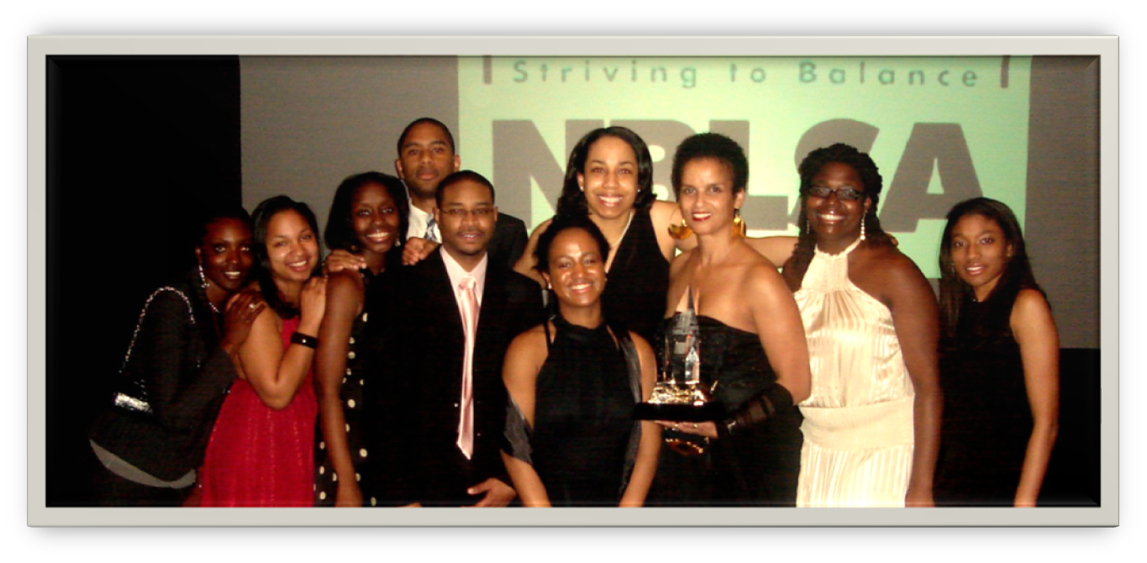
The Moot Court Experience
OSD external opportunity with a 3L preference
A great experience in teamwork, research, rigorous writing, and oral advocacy skills
Participation may fulfill upper level writing requirement
Particpants with excellent academic standing needed!

Slide 16
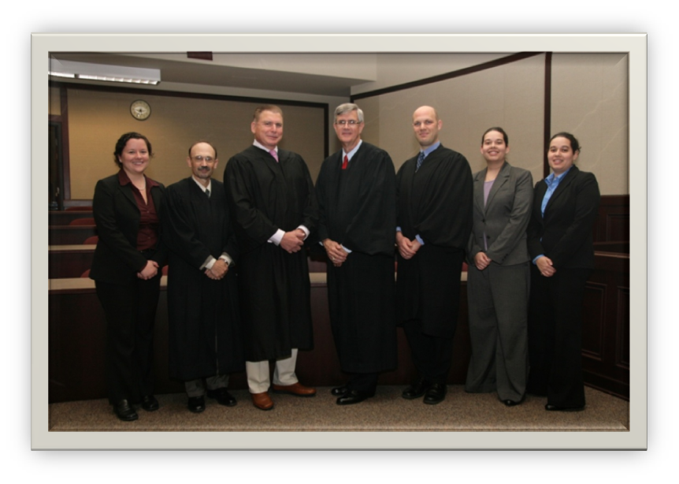
Overview
Teams develop a persuasive analysis of a legal problem
Prepare a written brief and argue before an appellate panel
Faculty advisors offer assistance in developing arguments
Focus on appellate advocacy and understanding of an area of law
Select competitions are financially sponsored by NUSL
All mock trial competitions are accessible on the OSD site on MYLAW MyLaw.slaw.neu.edu

Slide 17
The Writing Competition Experience
OSD external opportunity for all 2L and 3L students
May fulfill upper level ABA writing requirement
Cash awards and opportunity for publication
Overview
Showcase an area of deep legal interest, enhancing resume-based marketability
Competitions in over 100 areas of strength or interest
An alumnus ‘coach’ will help student develop a publishable quality paper
Final papers may be submitted to a faculty member, who may grant ABA upper level writing requirement approvals
To search and view all writing competitions, visit the OSD site on MYLAW
MyLaw.slaw.neu.edu

Slide 18
The Awards Experience
OSD external opportunity for all 2 Ls and 3Ls
cash, scholarships, or other awards
Overview
Recognition for work already accomplished
Most external awards are self-nominating
Aid in preparing nomination materials from the OSD Director
Some competitions require NUSL official nomination as outlined on the Awards Section of the OSD site on WeBoard
All awards can be browsed on the OSD site and most awards will also be announced on the MYLAW.
For more info and to view all of the Awards, visit the OSD site on WeBoard.
MyLaw.slaw.neu.edu

Slide 19
For complete access to and information regarding all opportunities, visit the OSD Site on MYLAW
Mylaw.slaw.neu.edu
Scholarships and Awards
Fellowships
Teaching and Research Opportunities
Moot Court, Mock Trial, Advocacy and Mediation Competitions

